Slide 1
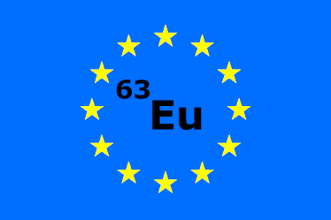
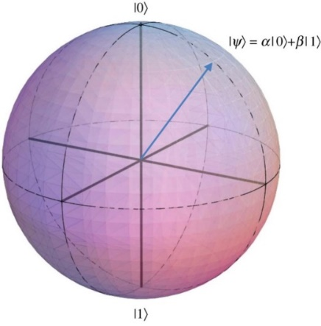
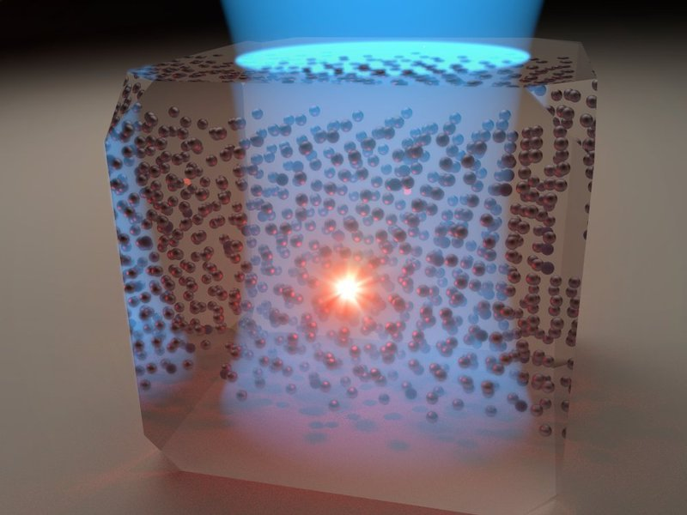
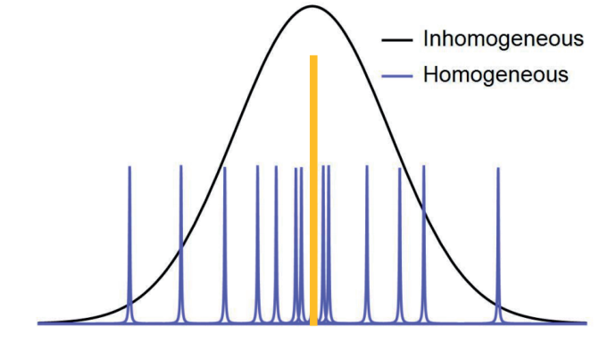
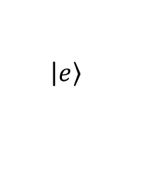
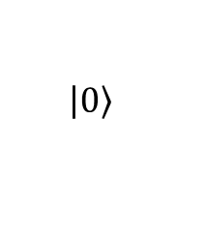
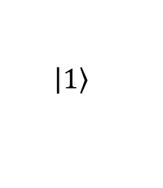
Quantum Computing with Rare Earth Ions
4f
$$\left|\left.e\right\rangle \right.$$
5s
5p
Outstanding coherence properties
$$\left|\left.0\right\rangle \right.$$
$$\left|\left.1\right\rangle \right.$$
Optically addressable spin qubits
© MPI für die Physik des Lichts
Solid state host: scalability through spectral multiplexing
Notes:
Storyline:
REI have outstanding coherence properties in the nuclear spin transition as well as for the opt. Transition
This is due to the electronic transitions within the 4f-shell which are shielded against environmental noise (Faraday cage)
Therefore, REI species are good candidates for optical quantum computing or quantum communication tasks
We make use of optical transitions which can manipulate the nuclear spin state
Spin can be used as logical qubit to store qm. Info for long times (long coherence)
The great advantage of REI doped into solid state hosts is that the individual ion lines (homo. Lines) fan out over a broad spectral window (inhomo. Line)
Using a narrow laser line one can spectrally select which ion one wants to talk to and manipulate (gate operations)

